Slide 1
a
Cell
Prior information
Calculate kNN overlap
X
Normalize(X)
Cell type
b
Cluster type
X
Calculate NMI and ARI
Normalize(X)

Slide 2
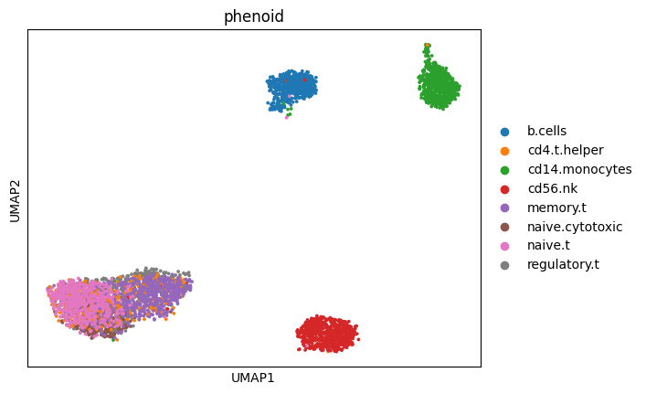
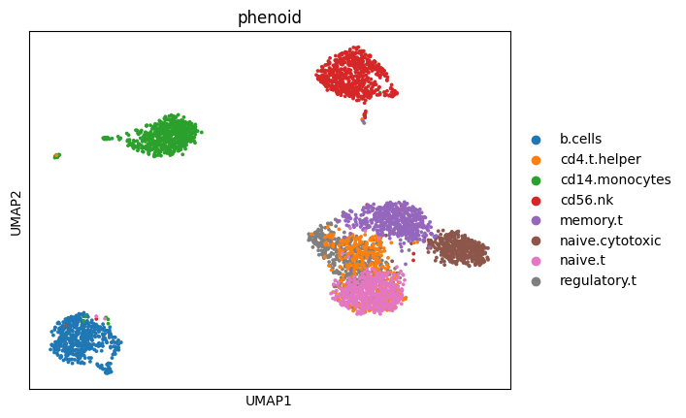
a
b
Raw data
sctransform
Cell Type
Cell Type

